Slide 1
Dataset Element Automation
Prototype

Slide 2
Updating Business Datasets
Currently updating Business Datasets is a manual process. In the web interface, a user needs to add element by element. The solution I’ve created have these features:
Modify a config file to provide a list (including wildcards) of technical elements to associate to Business Datasets.
Allow for criteria, like only include if the element has a Business Name and/or a Business Term
Also allow for bulk deleting of element associations
Also allow for Business Dataset to Business Dataset lineage

Slide 3
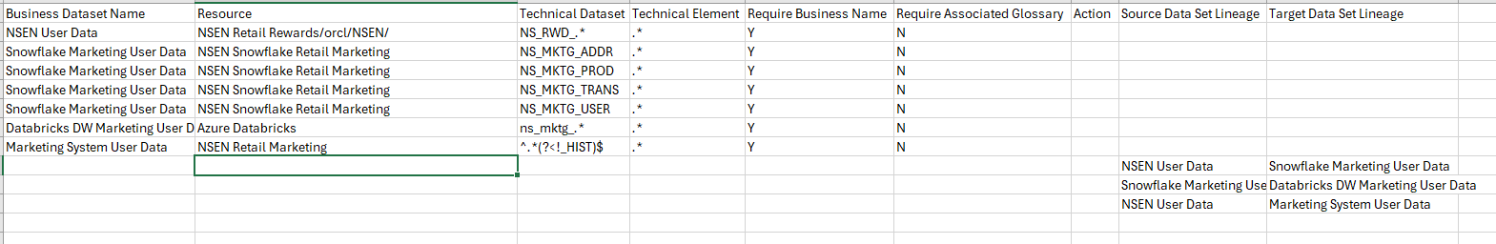
Configure with config.csv
Provide the name of the Technical Dataset (table, view, filename, etc). This can be a simple name, wildcards, or Regular Expression
Provide the Business Dataset Name (must be created already)
Provide Y/N flag on weather the element in question needs to have a Business Name to be included
Optional. If deleting an association, fill in with DELETE. Otherwise, the behavior will be to create the association
Optional. If adding lineage, provide the Target Business Dataset Name
Provide the Resource Name that contains the Dataset to be added. Can also be a “path”, such as database, schema, folder, etc
Provide the name of the Technical Element (column, field, etc) that exists in the dataset. This can be a simple name, wildcards, or Regular Expression
Provide Y/N flag on weather the element in question needs to one or more glossary terms associated to be included
Optional. If adding lineage, provide the Source Business Dataset Name

Slide 4
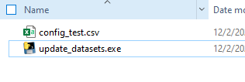
Additional Information
By default, the script will prompt to choose a csv file in the same folder as the executable, you optionally, you can also pass the name of your csv file as a command line parameter. For example:
An exe file is also available for running on windows, where python is not installed. Simply execute, or doubleclick in Windows explorer.
Additional flags can be set on the script:
default_pod. Set this to the default Informatica POD to use. Example: dm-us
default_user. Set this to the default user to use. Example: shayes_compass
default_pwd. Set this to the default password to use. Example: 1234
prompt_for_login_info. True/False. Whether or not to prompt. If False, will not prompt, unless default is not set
pause_before_loading. True/False. Whether or not to pause after payload files are created, before loading the classifications.
show_raw_errors. True/False. If set to True, it will always show raw errors if they occur. Otherwise, it will attempt to find the message from the error, and display that.
python update_datasets.py my_config.csv
Optionally, you can create a credentials file in ~/.informatica_cdgc (c:\Users\<username\.informatica_cdgc for Windows). If it finds a default profile, it'll use it, otherwise it'll prompt for which profile to use. If you credential file exists, you will be prompted. Example credentials file:
[default1] pod = dmp-us user = shayes_example pwd = xyz [shayes_compass] pod = dmp-us user = shayes_compass pwd = abc

Slide 5
Output
Sample Output:
Note that if an error occurs, it will skip that association and continue
INFO: update_dataset 20241202 Select a CSV file: 1. config_test.csv Enter the number of the file to select (1-1): 1 INFO: No 'default' profile found. Please select a profile: 1. Testing 2. shayes_compass 3. reinvent Enter the number of the profile to use: 2 Using credentials from the 'shayes_compass' profile. INFO: Cleaning up data INFO: Loading preliminary data Enter pod (default: dmp-us): Enter username (default : shayes_compass): Enter password: INFO: Loading data for "NSEN Retail Rewards" INFO: Looking at appropriate elements in: NSEN Retail Rewards/orcl/NSEN/NS_RWD_PROD INFO: Looking at appropriate elements in: NSEN Retail Rewards/orcl/NSEN/NS_RWD_TRANS INFO: Queuing Insert Element in "Test": RWD_POINTS | Business Name: Reward Points | Terms: ['Reward Points'] INFO: Queuing Insert Element in "Test": PRODUCT_ID | Business Name: Product Identification | Terms: ['Product Identification'] INFO: Queuing Insert Element in "Test": RWD_TRANS_DATE | Business Name: Transaction Date | Terms: ['Transaction Date'] INFO: Queuing Lineage from "Test" to "Snowflake Marketing User Data" Press Any Key to load ... INFO: Publishing Element in "Test": RWD_POINTS INFO: Publish successful INFO: Publishing Element in "Test": PRODUCT_ID INFO: Publish successful INFO: Publishing Element in "Test": RWD_TRANS_DATE INFO: Publish successful INFO: Publishing Element in "Test": CC_NUMBER INFO: Publish successful INFO: Publishing Lineage from "Test" to "Snowflake Marketing User Data" INFO: Publish successful Press Any Key to exit ...

Slide 6
Thank You
Questions / Issues / Suggestions:
Scott Hayes
shayes@informatica.com

